Slide 1
Phone-Brain Interface
Setup Guide and running instructions.
Lenis merino, zijing mao, Abdurrahman akuzum

Slide 2
Test the code on real device
Android Emulator is generally NOT GOOD for real-time applications, please use a real device as it is highly recommended.
For any questions or troubleshooting about running this app, please contact:
Lenis Merino – lmauriciomb@gmail.com – 210 772 8256

Slide 3
You will need
A Host computer
A cellphone, you need to get the IP address of the phone.
Both connected to the same wireless network
IntelliJ on the computer to run the client software.
Please watch the following VIDEO DEMOSNTRATION

Slide 4
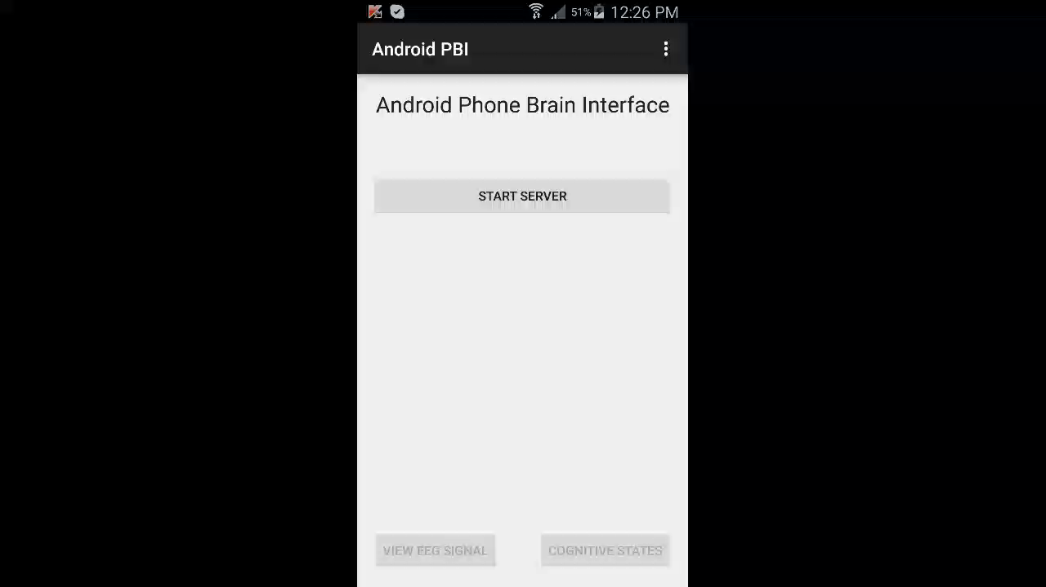
Video Demonstration

Slide 5
Instructions: Setting things up
Open the Client project using IntelliJ (of course computer has Java compilers and IntelliJ)
Locate the file called Main.java but don’t run it yet. On line 56 Insert the current Phone’s IP address
Open Android Studio and Run the application on the phone so app is downloaded on the phone. After that you don’t need cable connection.
On the App home screen, select START SERVER
As a thumb rule ALWAYS start the server first and THEN run the client program (Main.java)
IF both the phone and computer are connected to the same Wi-Fi network there should be no problem starting the server.

Slide 6
Instructions: Setting things up
Once server is started the buttons at the bottom get enabled, select then VIEW EEG SIGNAL
When seeing the “Gathering EEG signal…” message run the Main.java file on the host computer.
After a few Seconds you should see a real-time graph of the incoming recordings.
You may want to go to home activity or the COGNITIVE STATES activity (using bottom buttons ) to see another graph.
In “About Us”, “Help” or “Donate” activities press the phone’s back button to return to home activity.

Slide 7
Instructions:
Open Client Project (Java – Intellij)
Insert Phone’s IP address on Main.java file
Open App and start Server
Go to either VIEW EEG SIGNAL or COGNITIVE STATES activities using bottom buttons
Wait for a few seconds you should see real-time graphs
You should be able to move between activities and graphs should resume quickly.

